Slide 1
Agenda
IT PMP Path to Delivering Projects at EnCana – Using for Livelink Deployments
Livelink Deployment Approach
  General -- Document Management / Collaboration Projects
  Share Drive Conversions
  Workflow Implementations
  Records Management Implementations
Livelink Implementation Templates
  Configuration Workbook
  Training Checklist
  Transition to Support Checklist
  Use of Project Workspaces for managing Livelink Projects
The Role of Testing in Livelink Deployments
Why Change Readiness in Livelink Deployments?
Looking Back at Projects . . .

Slide 2

Livelink Implementation
Knowledge Transfer Session
INFORMATION MANAGEMENT
Livelink TEAM
November 8, 2026
Instructor: Sime Grzunov x. 9023
Notes:
This slide may be used at the beginning of presentations. It will have to be placed into your presentation manually and is not part of the template.
Do not add copy or graphics to this slide.

Slide 3
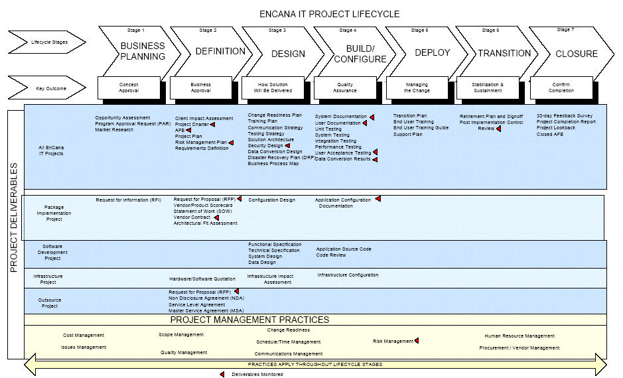
IT PMP Path to Delivering Projects at EnCana – Using for Livelink Deployments

Slide 4
Livelink Deployment Approach
  General -- Document Management / Collaboration Projects
  Share Drive Conversions
  Workflow Implementations
  Records Management Implementations

Slide 5
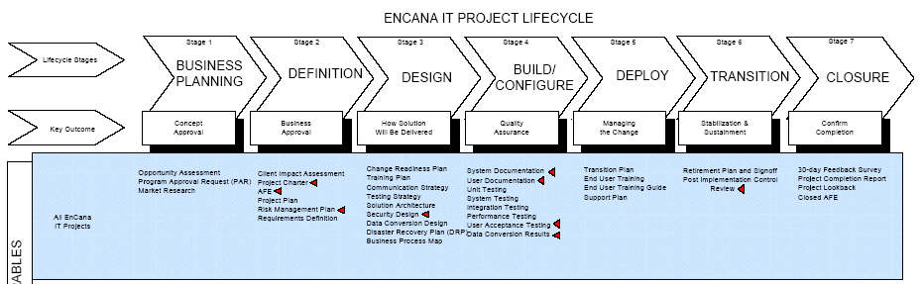
Livelink Projects and the IT Project Lifecycle
Opportunity Assessment Change Readiness Plan Support Transition Checklist Project Lookback
Charter Training Plan/Checklist Training/Testing Project Completion Report
AFE Configuration Workbook 30 day Feedback Closed AFE

Slide 6
General Considerations for All Projects
What business problems is the client having in managing information currently? i.e.: What are the business drivers/objectives? Example:
  Improved version management
  Improved browse and/or search
  Ability to track both electronic and physical information in one interface?
What opportunities are there for collaboration in/out of the group – e.g. external teams, departments, regions.
How can information be stored that is intuitive (from a browsing and a searching perspective)?
What categories and attributes can be applied to this information to facilitate improved searching. Suggestions:
  What other Cats/Atts have been created at EnCana to-date?
  Keep it simple.
  Mandatory vs. optional – search results may be compromised if not mandatory.
Avoid miscellaneous/general/bucket folders whenever possible.

Slide 7
General Considerations for All Projects
Functional- or activity-based hierarchies will avoid rework vs. organizational hierarchies based on a ‘teams information’. Encourage use of Aliases/Favorites/Collections to group information rather than creating organizational hierarchies.
Working with a client group to make a folder hierarchy RM-friendly now may minimize rework to folders later (RM class inheritance considerations).
Identify early on who the ‘expert users will be’. These become important support role in post-Go Live.
Restrict who has ability to create new folders! Risk is that you create the information landfill that the share drives have become!
Review the security/permission model closely with team to ensure information will not be made accessible to those who should not see it but yet information that can be made available to EnCana internally is!

Slide 8
Share Drive Conversion
Same considerations as General/Document Management projects plus:
How is share drive organized today? Are there room for improvements/cleanup.
What information maintained on the share drive are non-records and can be destroyed as they are no longer required?
Are there any special file types on the share drive (e.g. databases, linked spreadsheets)? What are to be done with these?
Can the share drive be made read-only or folders be deleted upon conversion?
How will you handle the conversion? Bulk Loader to be used or drag & drop? Note: System impacts.

Slide 9
Workflow Implementations
What is the client’s familiarity with Livelink? (may not want to consider a workflow project until they have been using for basic document mgmt.)
Detailed analysis of business process required.
If you can draw it in a Visio diagram it is a ‘candidate’ for a Livelink workflow

Slide 10
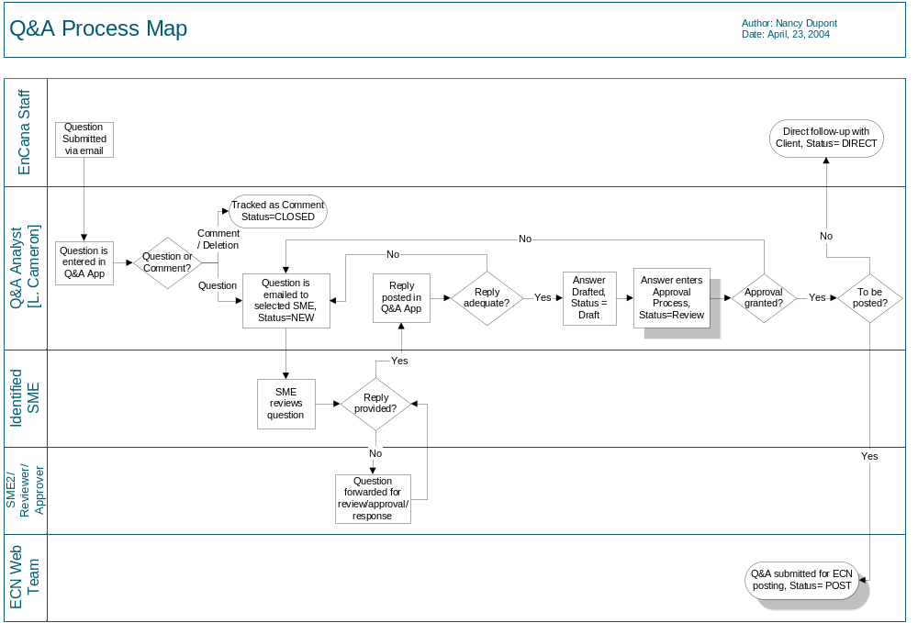
Workflow: Mapping the Business Process

Slide 11
Workflow: Describing the Workflow
Workflow Technical Specification Document Example: Q&A Workflow
Use the Specification Document to capture the various tasks and attributes for each.

Slide 12
Records Management
Need to identify all the records created and received by the group. Will likely require analysis of each document (e.g. is it an accounts payable invoice or accounts receivable – consider what the activity is that caused the record to be created or received).
Group the records under folders where 1 RM class can be applied to the folder to leverage RM inheritance and to minimize end users having to classify their records. E.G Project Initiation folder for an LL project contains the OA; the Charter and the Schedule – these are all classified IN01. The Folder didn’t have to be titled the same as the class, but the users need to understand clearly what records should and should not be stored in that folder!

Slide 13
Records Management (continued)
How (or will) the group use the Mark Official feature in LLRM? This downgrades permissions to See/See Contents.
What are the labeling requirements for physical items? Can existing labels be leveraged?
How will physical records be cross-referenced with their electronic counterparts? E.g. A MS Word version of a contract, with the printed paper copy and a scanned image of the same document! Make sure they have the same RM class code!
Who is the RM Officer for the group? Will they have permissions to see the records that are classified that may be requested for deletion? Who is the RM Manager for the group?
Physical item tracking does not require Livelink RM module however -- LLRM can be used to manage retention on both electronic and physical items managed in Livelink!

Slide 14
Livelink Implementation Templates
Configuration Workbook
Training Checklist
Support Plan Template
Using Project Workspaces and LL to manage your projects

Slide 15
Using the Configuration Workbook
The configuration workbook is used by PM’s, BA’s; local and Livelink System Admin to:
  To identify what Users and Groups are to be created or revised in LL.
  Identify what the folder hierarchy in LL is to look like at implementation including owners, permissions, categories and attributes etc. and how it is to be created or converted etc.
  Identify post-implementation share drive structures, how special files are to be handled, scanning requirements etc.
  The RM classifications that are to be applied to folders.
Can also be used for small projects to capture the project charter content as part of the one workbook
Exercise: Review the Workbook

Slide 16
Training Checklist
To be completed as early on in the process as possible.
Consider the deployment and the specific training, communication and change readiness needs of your specific deployment.
Exercise: Review the Checklist

Slide 17
Transition to Support Checklist
Used by Livelink Client Services/Support; your application/desktop support.
Exercise: Review the Support Checklist

Slide 18
Use of Project Workspaces to Manage your deployments
Engage the Sponsor, Key Business Contact and Expert Users early by tracking all project documentation in a workspace.
Send links to documents stored in the workspace such as the charter, meeting minutes etc.
Encourage the team to browse in the workspace and LL early on!
Create a discussion forum (if applicable) for your clients to start practicing with and asking questions.
Using the LL Project Workspace template for tracking project document’s.

Slide 19
The Role of Testing in Livelink Deployments
Was all the information migrated from the share drive?
Were all the folders created correctly?
Were all the permissions applied appropriately (according to the configuration workbook?) What’s the risk if they were not?????
Does the workflow function correctly in all business use cases?
Were all the records classified correctly?
Did the system integration work as expected?
Does your new integration work as expected?
Did the upgrade affect any other systems or Livelink integrations?

Slide 20
Why Change Readiness?
Change readiness supports the use of Livelink in ways that create business value by:
  Understanding Livelink’s impact on business practices and roles;
  Ensuring new work practices and roles for Livelink’s use are defined;
  Supporting people’s transition to Livelink through targeted communications and training.

Slide 21
Why Change Readiness?
Livelink is not just about a share drive replacement!
Without change readiness in LL projects, we have seen:
  Frustration and confusion
  Difficulty in seeing the value in Livelink
  Less or no willingness to tackle the learning curve including a refusal to use Livelink.
With change readiness:
  No issues with buy-in
  Project a priority for everyone
  Minimal support required for LL post-implementation because users engaged and expectations set in advance.
  Training sessions go more smoothly
  Project timelines and budgets maintained as no distractions or confusion regarding objectives or scope mid-way through the project.

Slide 22
Looking Back at Projects . .
Several hundred projects implemented at EnCana.
Projects anywhere from several months in duration to a few hours.
Typical project team resources: PM/BA, Client Business Contact and Exper User(s); Tester; System Admin; Change Readiness, Training/Documentation. Developer time required for any custom integrations, LiveReports or Workflow Development.

Slide 23

Questions??

